Slide 1
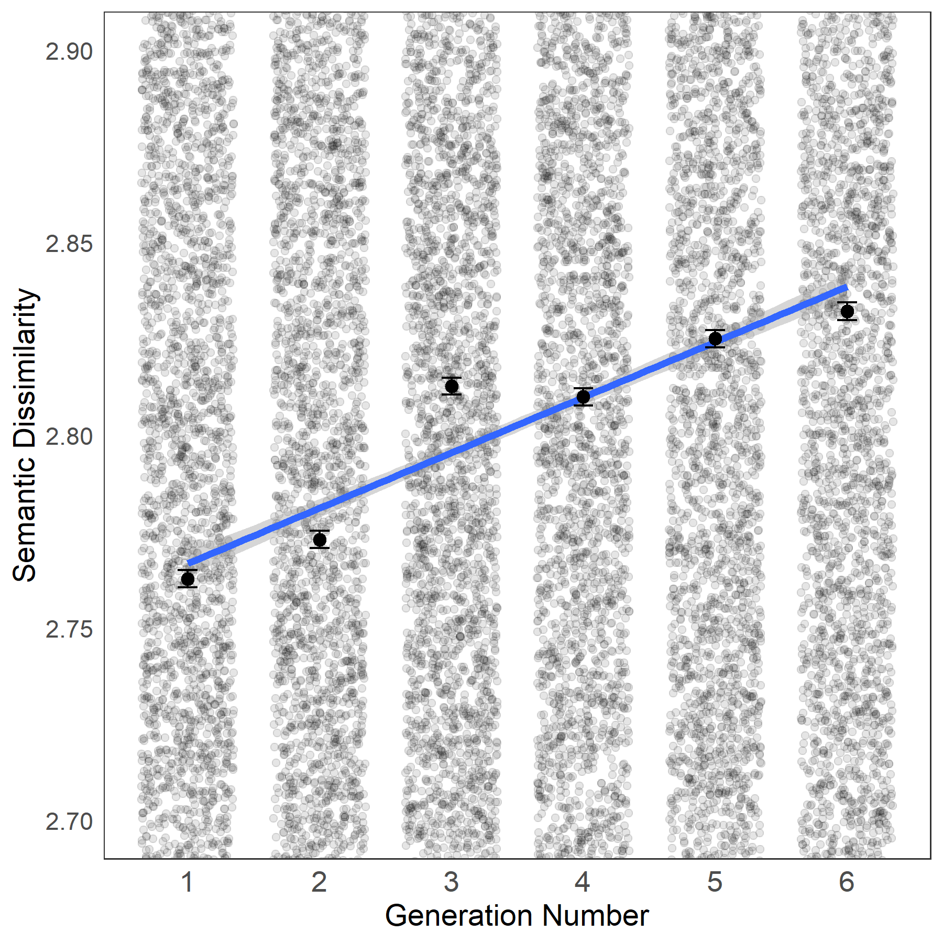
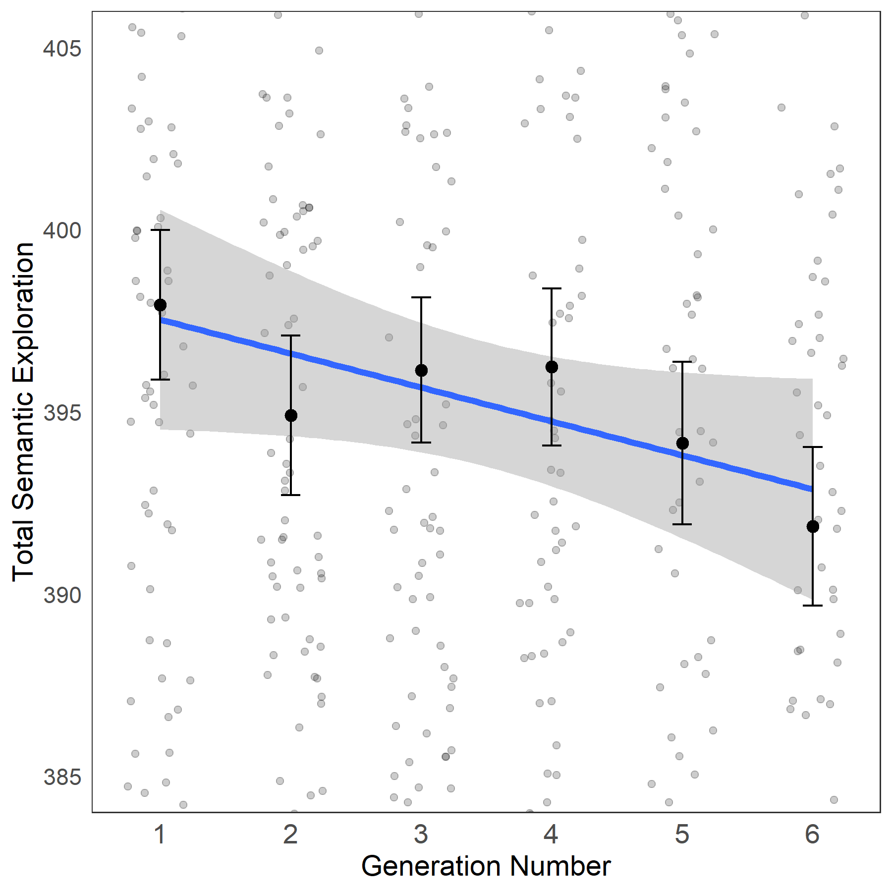
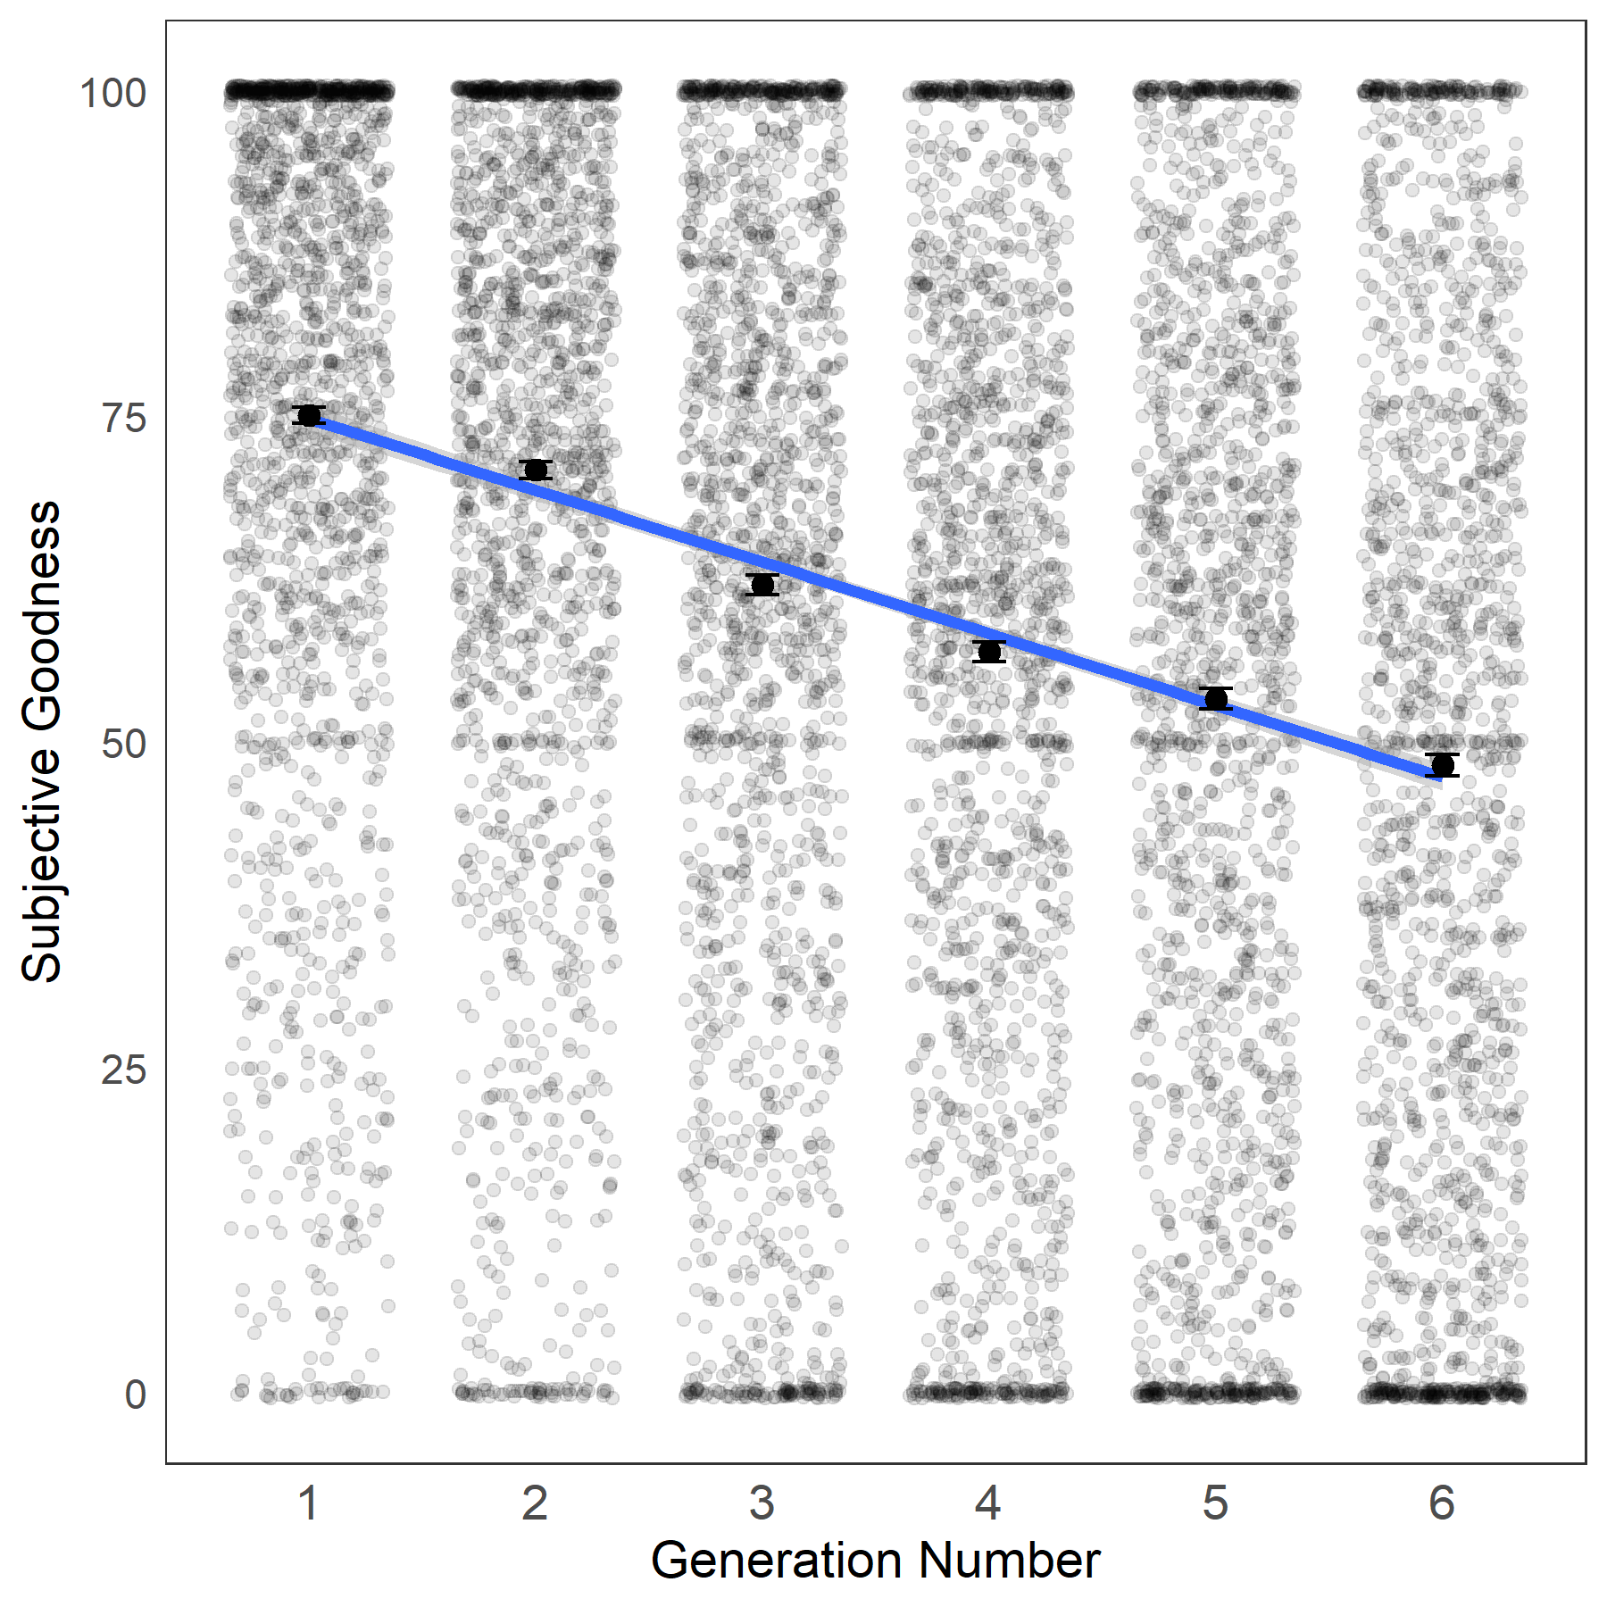
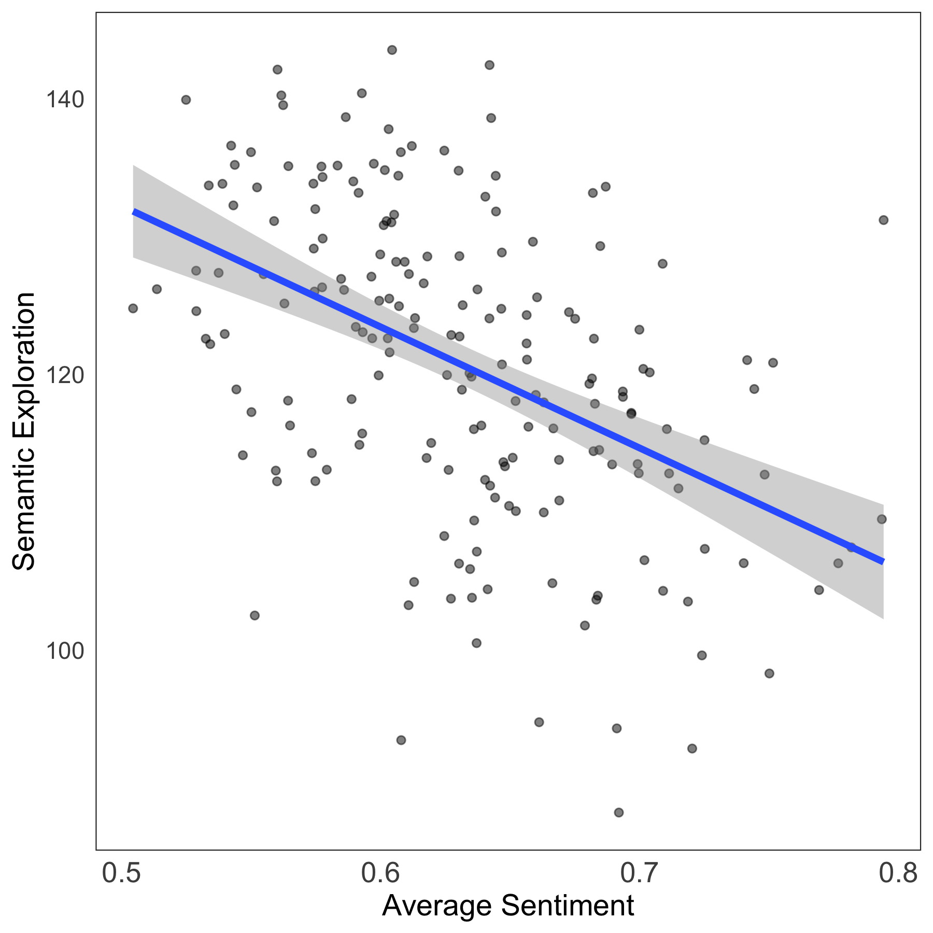
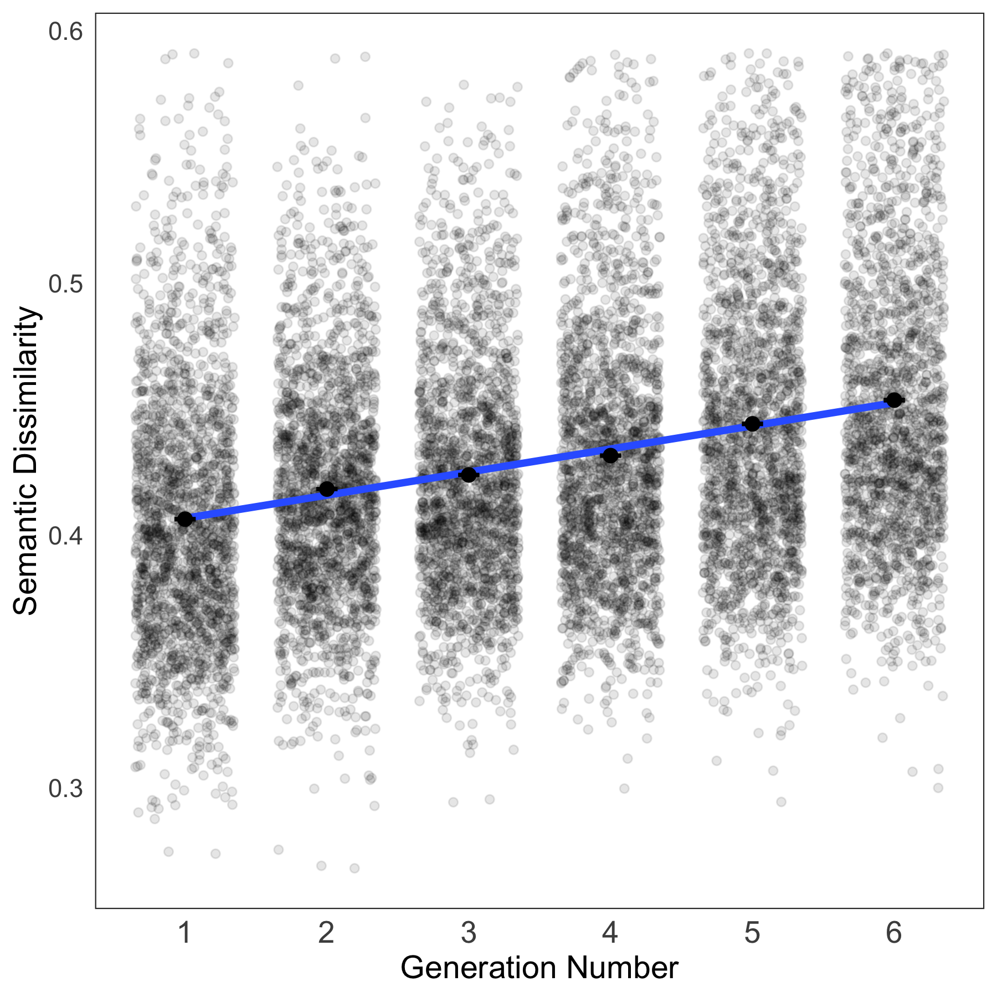
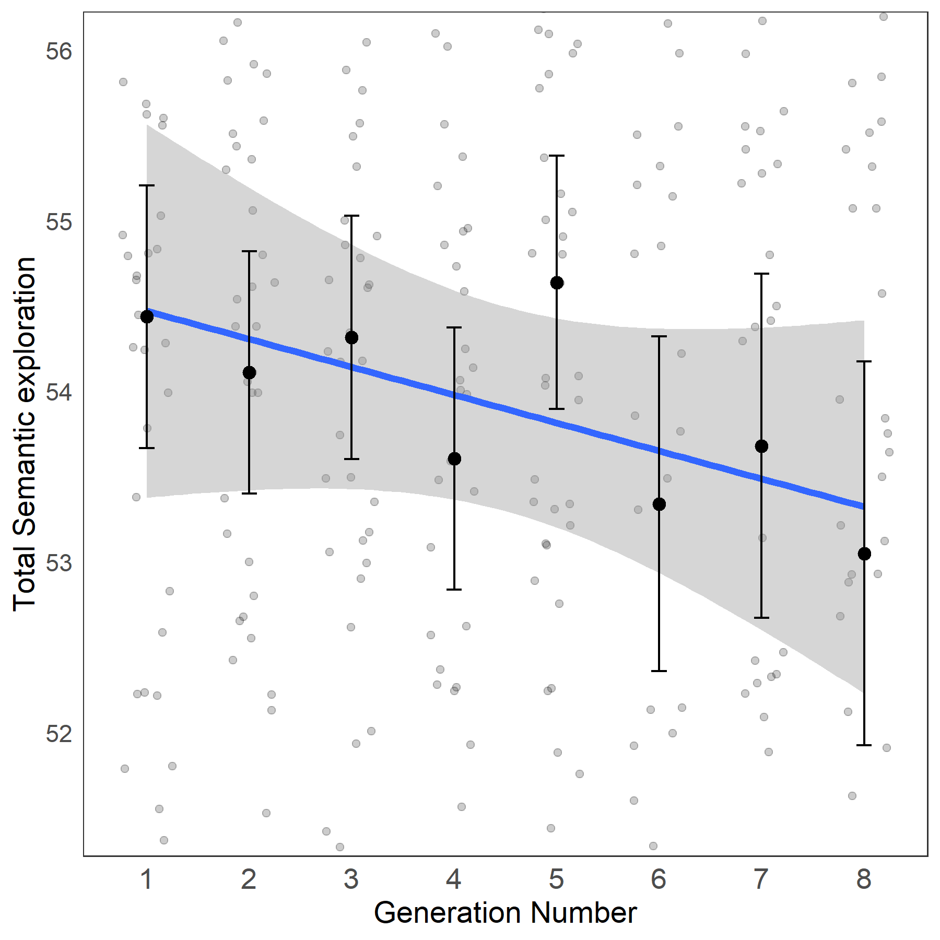
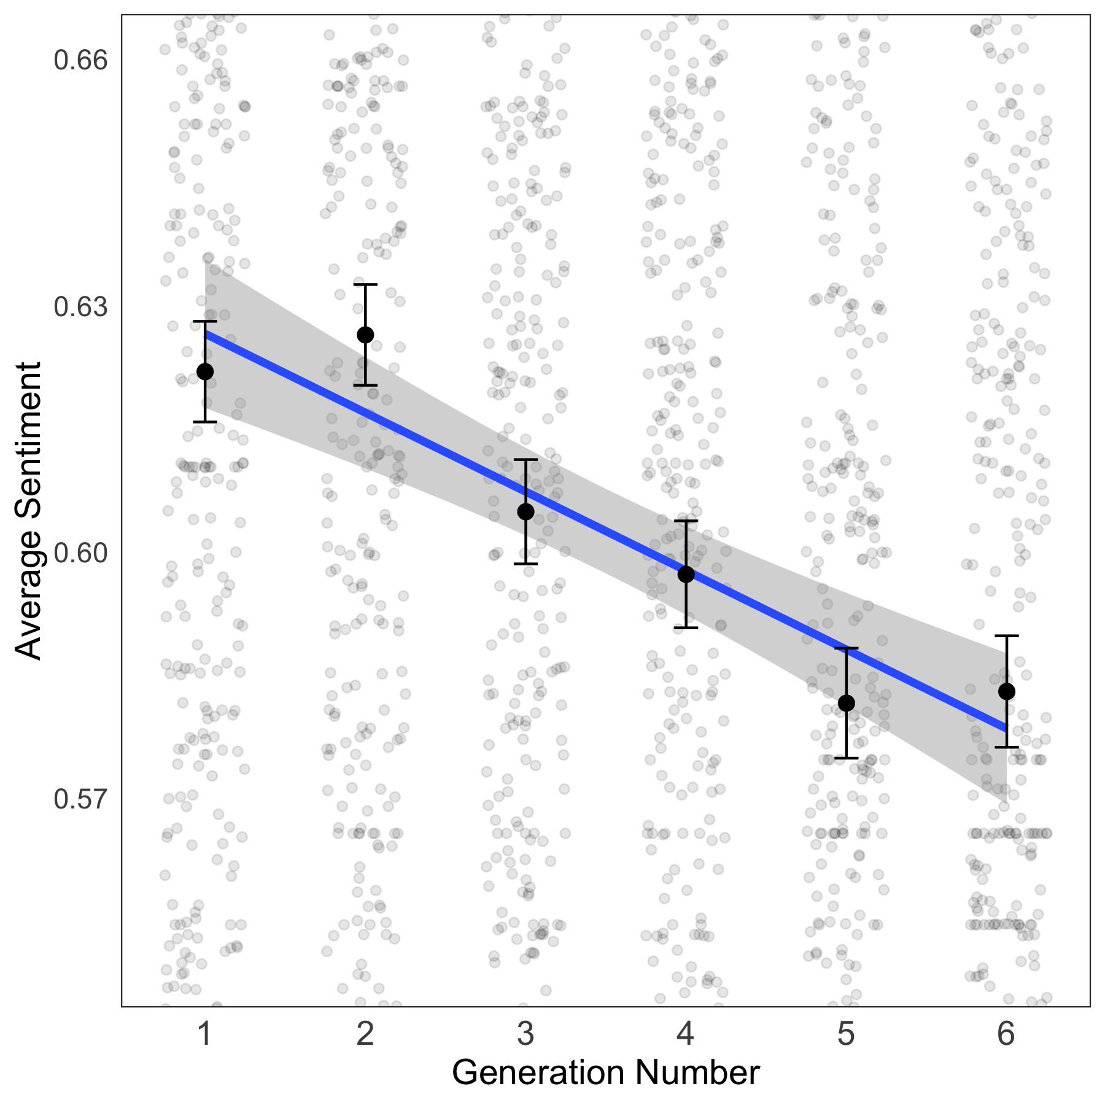
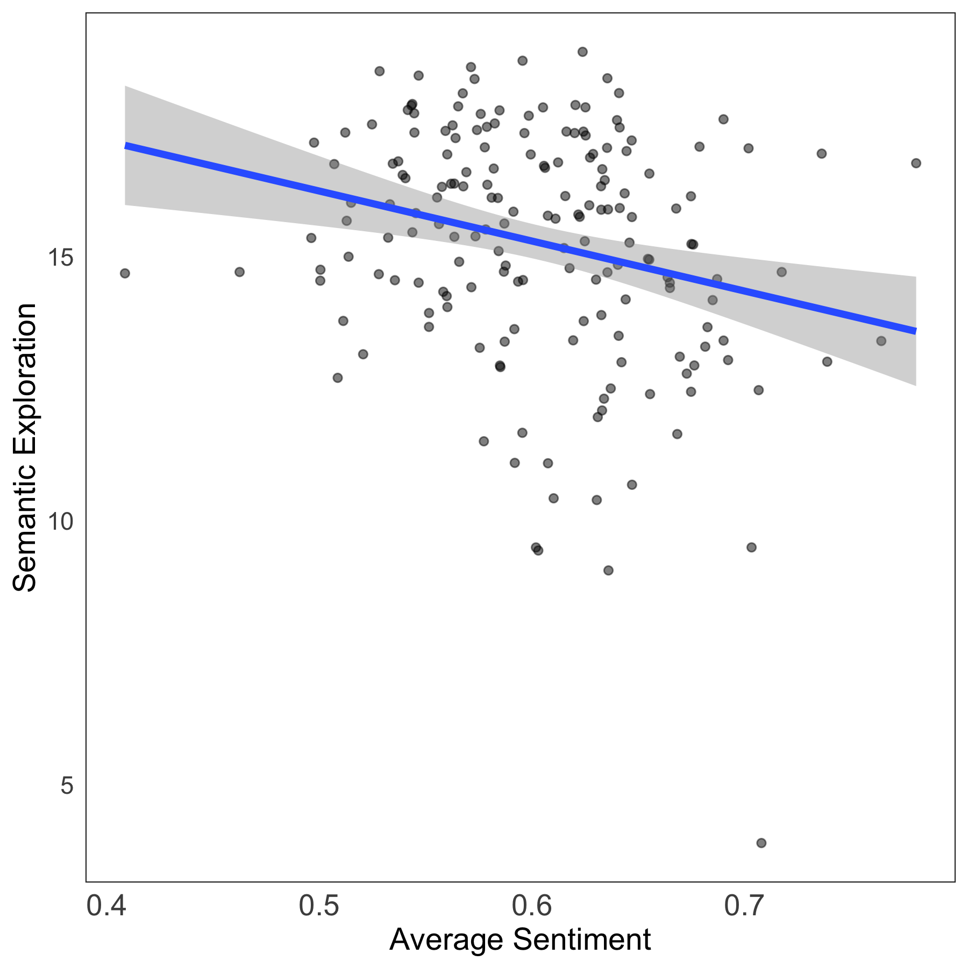
The shape of option generation in open-ended decision problems
Gokul Srinivasan, Jane Acierno, Jonathan Phillips
Program in Cognitive Science, Dartmouth College
Background
Study Design
Example Vignette
Three separate experiments were conducted in which a total of 477 participants (N_{study1} = 197, N_{study2} = 178, N_{study3} = 102) were recruited from Prolific (M_{age} = 41.2; SD_{age} = 12.4; 56% women). All studies employed a similar design. Participants read several background contexts, ranging from 8 (Study 3) to 10 (Study 1 and 2), which described a unique open-ended decision problem. The order of presentation for the decision-contexts was randomized.
“Your significant other has recently fallen ill and needs an expensive medication that is not covered by your medical insurance. You do not have the money needed to purchase the expensive prescription medication, but you know that it is vital for them to have it if they are going to recover. In this situation, what are some things you could do?”
Similarity of options as a function of number of options generated
Semantic exploration over generations
Subjective and objective value of options generated
Individual variation in exploration and sentiment
Research Question
Across studies 1-3, we sought to further understand how people solve open-ended decision problems by leveraging recent advances in large language models?
Implications
Study 1 (ρ = .912, p = .011)
Study 1 (ρ = −.860, p = .028)
Study 2 (ρ = .992, p < .001)
Study 1 (ρ = −.468, p < .001)
The process of option generation is biased towards options that are historically valuable, likely, and semantically accessible.
Each participant, when they are solving a range of different problems, tend to head towards a semantically similar, low value part of semantic space.
Language models provide a fecund analytic paradigm for delineating the manner in which people solve open-ended decision problems.
Study 2 (ρ = .980, p = .001)
Study 3 (ρ = −.712, p = .047)
Study 2 (ρ = −.954, p = .003)
Study 2 (ρ = −.246, p = .001)
While participants exhibited a higher degree of semantic convergence early on—exploring semantic space in a more similar way—they exhibited a lower degree of semantic convergence later on.
For a given participant, the first options that came to mind across different contexts tended to be unrelated to one another. However, as participants began to produce successive options across different contexts, the options they generated became increasingly similar to one another.
The first options that come to mind for open-ended decisions tend to be the highest in subjective and objective value (measured by sentiment analysis), and subsequent options seem to linearly decrease in value.
Participants who tended to explore more diverse regions of semantic space also tended to generate options with lower value (as estimated by sentiment analysis).

Slide 2
The shape of option generation in open-ended decision problems
Gokul Srinivasan, Jane Acierno, Jonathan Phillips
Program in Cognitive Science, Dartmouth College
Background
s
Research Question
Across studies 1-3, we sought to further understand how people solve open-ended decision problems by leveraging recent advances in large language models?
Implications
Study Design
Three separate experiments were conducted in which a total of 477 participants (N_{study1} = 197, N_{study2} = 178, N_{study3} = 102) were recruited from Prolific (M_{age} = 41.2; SD_{age} = 12.4; 56% women). All studies employed a similar design. Participants read several background contexts, ranging from 8 (Study 3) to 10 (Study 1 and 2), which described a unique open-ended decision problem. The order of presentation for the decision-contexts was randomized.

Slide 3



The shape of option generation in open-ended decision problems
Gokul Srinivasan, Jane Acierno, Jonathan Phillips
Program in Cognitive Science, Dartmouth College
Background
Example Vignette
Subjective and objective value of options generated
Individual variation in exploration and sentiment
“Your significant other has recently fallen ill and needs an expensive medication that is not covered by your medical insurance. You do not have the money needed to purchase the expensive prescription medication, but you know that it is vital for them to have it if they are going to recover. In this situation, what are some things you could do?”
When expert chess players look at a board, they immediately have a sense for potential moves, and often the first possibility that comes to mind is, in fact, the best move (Klein et al., 1995)
Prior research has either used highly constrained experimental paradigms or asked participants to reason over a limited set of options determined by the experimenters (Kalis, et al., 2013).
The possibilities that come to mind first often rank most highly in objective and subjective value (Morris et al., 2021).
Participants generate a relatively small set of options for explicit evaluation, and the process of option generation is biased towards options that are historically valuable, likely, and semantically accessible (Morris et al., 2021).
Similarity of options as a function of number of options generated
Semantic exploration over generations
Study 2 (ρ = .992, p < .001)
Study 1 (ρ = −.468, p < .001)
Research Question
Across studies 1-3, we sought to further understand how people solve open-ended decision problems by leveraging recent advances in large language models
Study 1 (ρ = −.860, p = .028)
Study 1 (ρ = .912, p = .011)
Study Design
Study 2 (ρ = −.954, p = .003)
Study 2 (ρ = −.246, p = .001)
Three separate experiments were conducted in which a total of 477 participants (N_{study1} = 197, N_{study2} = 178, N_{study3} = 102) were recruited from Prolific (M_{age} = 41.2; SD_{age} = 12.4; 56% women). All studies employed a similar design. Participants read several background contexts, ranging from 8 (Study 3) to 10 (Study 1 and 2), which described a unique open-ended decision problem. The order of presentation for the decision-contexts was randomized.
Results: The first options that come to mind for open-ended decisions tend to be the highest in subjective and objective value (measured by sentiment analysis), and subsequent options seem to linearly decrease in value.
Results: Participants who tended to explore more diverse regions of semantic space also tended to generate options with lower value (as estimated by sentiment analysis).
Implications
Study 2 (ρ = .980, p = .001)
Study 3 (ρ = −.712, p = .047)
The process of option generation is biased towards options that are historically valuable, likely, and semantically accessible.
Each participant, when they are solving a range of different problems, tend to head towards a semantically similar, low value part of semantic space.
Language models provide a fruitful analytic paradigm for delineating how people solve open-ended decision problems.
Results: While participants exhibited a higher degree of semantic convergence early on—exploring semantic space in a more similar way—they exhibited a lower degree of semantic convergence later on.
Results: For a given participant, the first options that came to mind across different contexts tended to be unrelated to one another. However, as participants began to produce successive options across different contexts, the options they generated became increasingly similar to one another.

